Slide 1
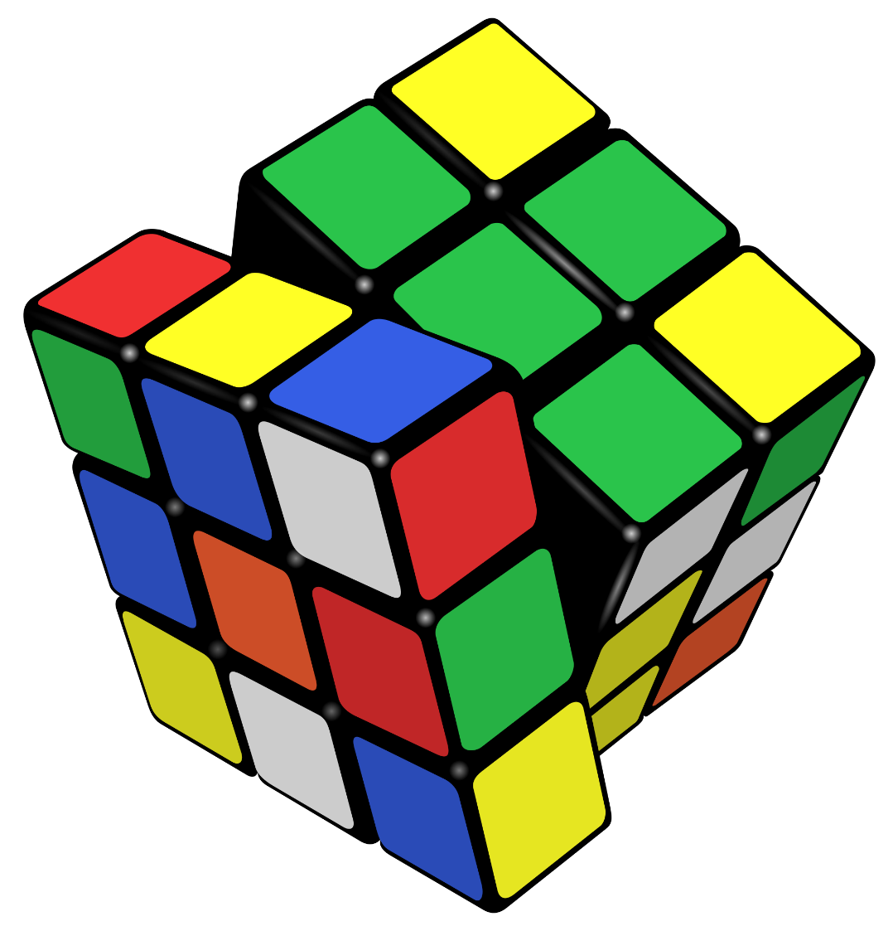
Rubik’s Cube
By :- Tarun R. Mahajan
My Mentor :- Mr. Devang Chauhan,
Mr. Adarsh Singh

Slide 2
Cube Entities
Java & JavaFX
3D Object/Image
3D Viewer (Background axis)
Camera
Event Handler
Key Listener
Mouse Listener
Button Action
Animation

Slide 3

RubikCubeFX is made in JavaFx.
JavaFX provides Graphics, Effects, Animation, and Media.
It is similar to Swing and AWT except it provides 3D Graphics

Slide 4
3D Object
OR
Using CSG
(Constructive Solid Geometry)
JavaFX 3D API

Slide 5
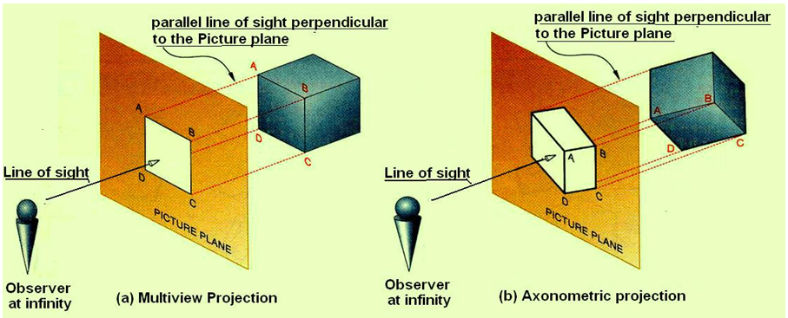
3D Viewer
Perspective View Of an Object

Slide 6
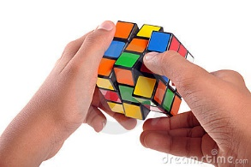
Bibliography
Building a 3D Sample Application with JavaFX :-
https://docs.oracle.com/javase/8/javafx/graphics-tutorial/sampleapp3d.htm
3DViewer :-
http://hg.openjdk.java.net/openjfx/8/master/rt/file/f89b7dc932af/apps/experiments/3DViewer
JavaFX tutorials :-
http://code.makery.ch/library/javafx-8-tutorial/

Slide 7
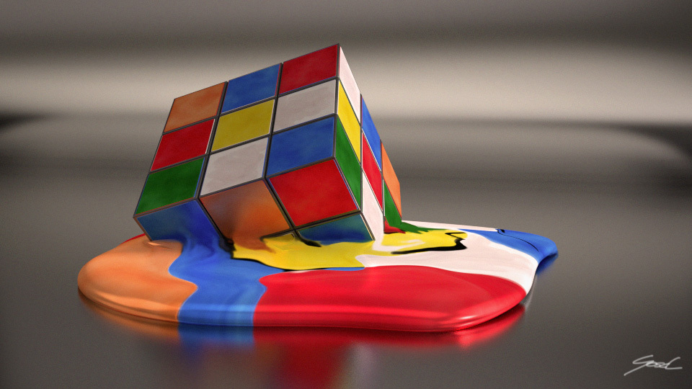
THANK YOU

